Slide 1
iCreate - Generative Design in Virtual Reality
Members:
Hannah Solorzano
Rhea Mae Edwards
Nabeel Shariff

Slide 2
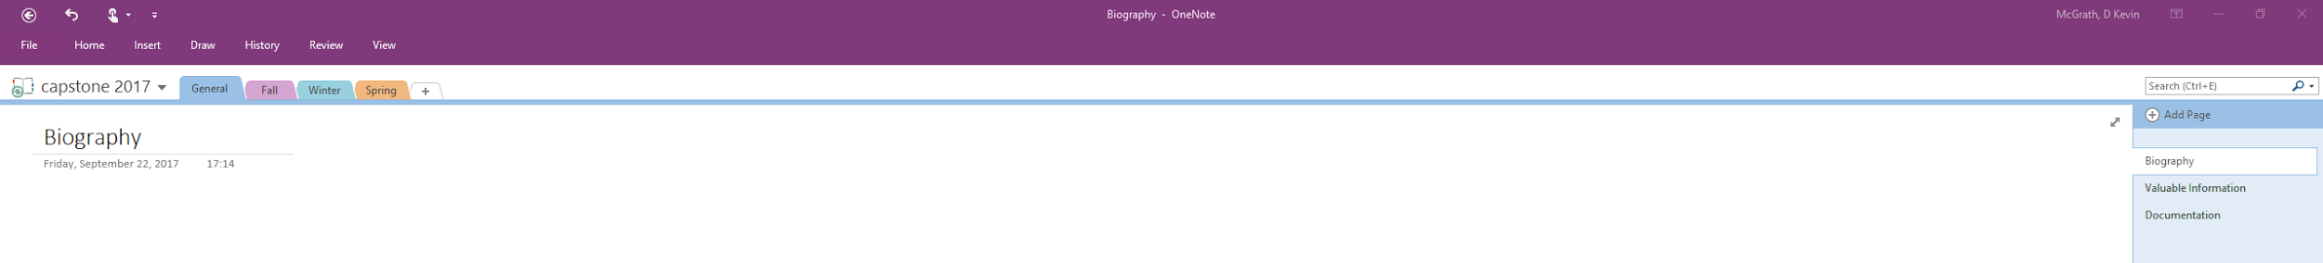
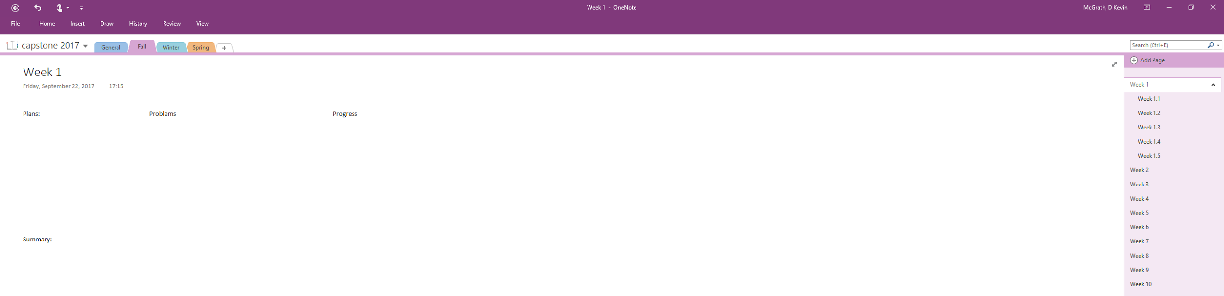
iCreate - Setting Up OneNote

Slide 3
iCreate - Written Biography
Future Self
Close to Retirement
Career and Highlights
Third Person Perspective
Achievements and Accomplishments

Slide 4
iCreate - Resumes
Basic Resume
Brought and Peer Reviewed in Class
Alternative:
Curriculum Vitae (CV)

Slide 5
iCreate - Project Preferences
Online Database
Top 5 Project Picks
Reasons Why Description Possibility
One Person Don’t Want to Work With Possibility
Talking with Clients Beforehand Possibility

Slide 6
iCreate - Receive Capstone Group
Client:
Dr. Raffaele De Amicis (RdA)
Research Professor of the College of EECS
TA:
Beham (Ben) Saeedi
Members:
Hannah Solorzano
Rhea Mae Edwards
Nabeel Shariff

Slide 7
iCreate - Contact Client
Email and bio:
raffaele.deamicis@oregonstate.edu
http://eecs.oregonstate.edu/people/de-amicis-raffaele

Slide 8
iCreate - Weekly Meeting Times
Client Meeting Time:
9AM → 4PM on Mondays
TA Meeting Time:
1:30PM - 2:00PM on Tuesdays

Slide 9
iCreate - Problem Statement, Individual Works
Individually Done
Own Views
Problem Definition
Proposed Solution
Performance Metrics

Slide 10
iCreate - Problem Statement, Final Draft
Group Work Document
Problem Definition
Proposed Solution
Performance Metrics

Slide 11
iCreate - “Under Promise, Over Deliver”
During week 4, the team met with Dr. Amicis and talked about an exercise to ease us into 3D development for VR. The exercise was to generate a roman water aqueduct via code, and we were asked by when we could deliver.
The TA suggested the best thing to do is to underpromise, and overdeliver. So the team thought three weeks would be sufficient for this task.
Additionally the team also completed the first team assignment which was the iCreate problem statement,
Notes:
Hannah and Nabeel
Week 4 Experiences
*Rhea Mae was attending a conference during Week 4 for work

Slide 12
iCreate - Aqueduct Implementation
For the purposes of getting into 3D development in VR, our client Dr. Raffaele De Amicis asked us to write code that could generate a 3D roman water aqueduct made from individual 3D bricks.
The team was able to successfully finish code that could generate several pillars, but forming the arch was challenge and is still incomplete.
Notes:
N

Slide 13
iCreate - User Requirements Document
The user requirements document (SRS) details iCreate’s specific requirements needed to be fulfilled to complete the project.
After integrating feedback from the instructors, client, and TA, the team was able to produce an excellent version of the iCreate SRS.
Notes:
N

Slide 14
iCreate - Technology Review and Implementation Plan (Rhea Mae)
Headsets
HTC Vive*
Oculus Rift
Playstation VR
Programming Languages
C#*
C/C++
Java
Connective Software
Dynamo
Grasshopper - Iris VR
LeapMotion

Slide 15
iCreate - Technology Review and Implementation Plan (Hannah)
Development Environment
Unity*
Unreal Engine
OpenGL
Graphics Card
GeForce GTX 970
NVIDIA TITAN Xp
AKiTiO Node Thunderbolt 3
User Controls
Oculus Rift Touch Controllers
Hands
Sony Controllers

Slide 16
iCreate - Technology Review and Implementation Plan (Nabeel)
User Interface
Non-diegetic UI
Spatial UI
Diegetic UI
Operating System
Microsoft Windows
Apple Macintosh
Linux
Distribution Methods
Steam Store
Oculus Home
Executable File
The tech review document served to look at the different components that go into developing iCreate, and choosing a technology for each component that best fit the project.
Notes:
N
The tech review document served to look at the different components that go into developing iCreate, and choosing a technology for each component that best fit the project.

Slide 17
iCreate - Design Document
Group Work Document
Individually → Group
Combining Technology Review and Implementation Plan documents

Slide 18
iCreate - Client Meetings
Possible Additional Slide
Only complete with additional time

Slide 19
iCreate - TA Meetings
Possible Additional Slide
Only complete with additional time

Slide 20
iCreate - Individual Experiences (Rhea Mae)
Possible Additional Slide
Only complete with additional time

Slide 21
iCreate - Individual Experiences (Hannah)
Possible Additional Slide
Only complete with additional time

Slide 22
iCreate - Individual Experiences (Nabeel)
Possible Additional Slide
Only complete with additional time

